Slide 1
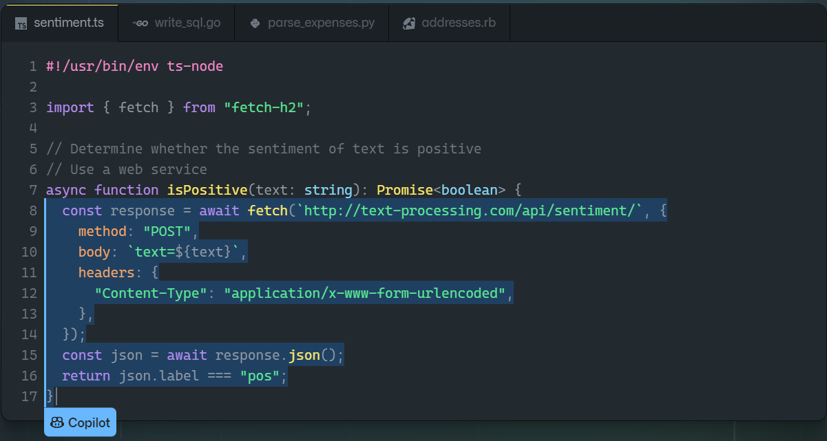
Github Copilot
Norbert Matuška
FIIT STU 2021/2022

Slide 2

What is GitHub Copilot?
AI tool created by GitHub and OpenAI
Currently only a technical preview
Works best for Python, JavaScript, TypeScript and so on

Slide 3
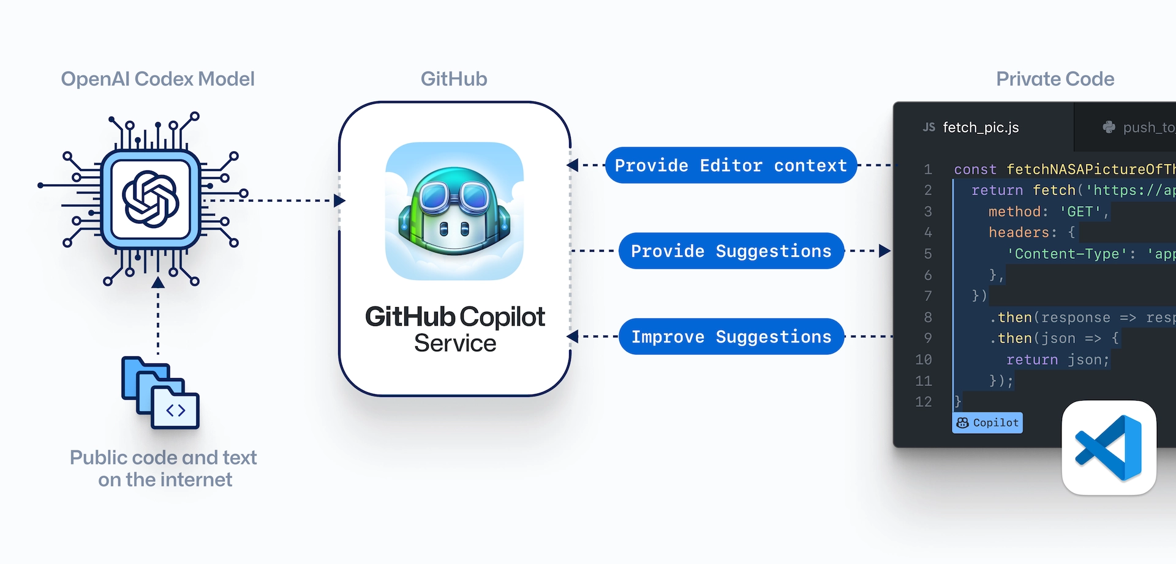
Features
Diagram of how Copilot basically works
Powered by OpenAI Codex – modified GPT-3
When provided with a programming problem in “natural language”, it is capable of generating solution code
Trained on the English language, GitHub repositories, public source code
159 GB of Python code from 54 million repositories

Slide 4
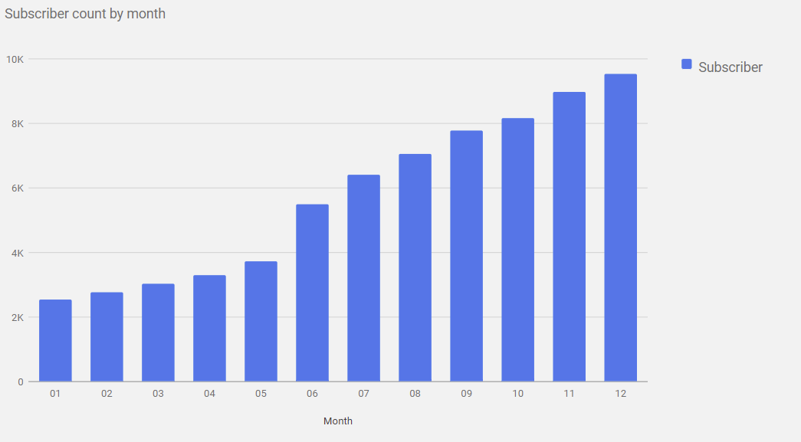
Features
Conversion of code comments to runnable code, autocomplete for chunks of code, entire methods and/or functions
Autocomplete feature accurate roughly half of the time
Allows programmers navigate unfamiliar coding frameworks
GitHub Copilot is here to stay
*2021

Slide 5
Controversies and concerns
Licensing controversy
small proportion is copied verbatim->fears
Copilot on untested legal ground
Security concerns
Study across 89 different scenarios and 1,689 programs
39.33% of top suggestions and 40.73% of total suggestions lead to code vulnerabilities
Education concerns
Codex, on average, performed better than most students
its performance decreased on questions that limited what features could be used in the solution

Slide 6
Questions
Would you like to see this AI completed someday?
Do you have any concerns? If so, what are those?
If this AI was near perfect, would you use it?

Slide 7
Questions for me?

Slide 8
Sources
https://copilot.github.com/
https://en.wikipedia.org/wiki/GitHub_Copilot
https://github.com/github/copilot-docs

